Slide 1
Predicting
DIABETES
Medi Insight Analytics Corp.

Slide 2





Meet the Team
David oceguera
Sanja kostic
Clare kim
Sheng (sean) zhi lUO
Tina Dehghan
T
0

Slide 3
TABLE OF CONTENTS
01
02
03
Background
Common factors
Logistic regression
04
05
06
Supervised learning
Neural network
Conclusion
Education on Diabetes & Geo/Demographic Significance
Determining relationships between health factors
Finding accuracy, precision,
recall, and F-1 score
Decision Tree and Random Forest
Checking the accuracy
T
0

Slide 4
01
background
In 2021, 38.4 million Americans, or 11.6% of the population, had diabetes.
T
1

Slide 5
DIABETES TYPE 1 AND 2
DIABETES
TYPE 1
TYPE 2
Autoimmune condition
Usually Genetic
Most Common
Body is resistant to insulin

Slide 6
THE EFFECTS OF DIABETES
Blurred vision
Fatigue and weakness
Autoimmune Reaction
Increased thirst and urination
Extreme hunger
Blood sugar levels
T
1

Slide 7
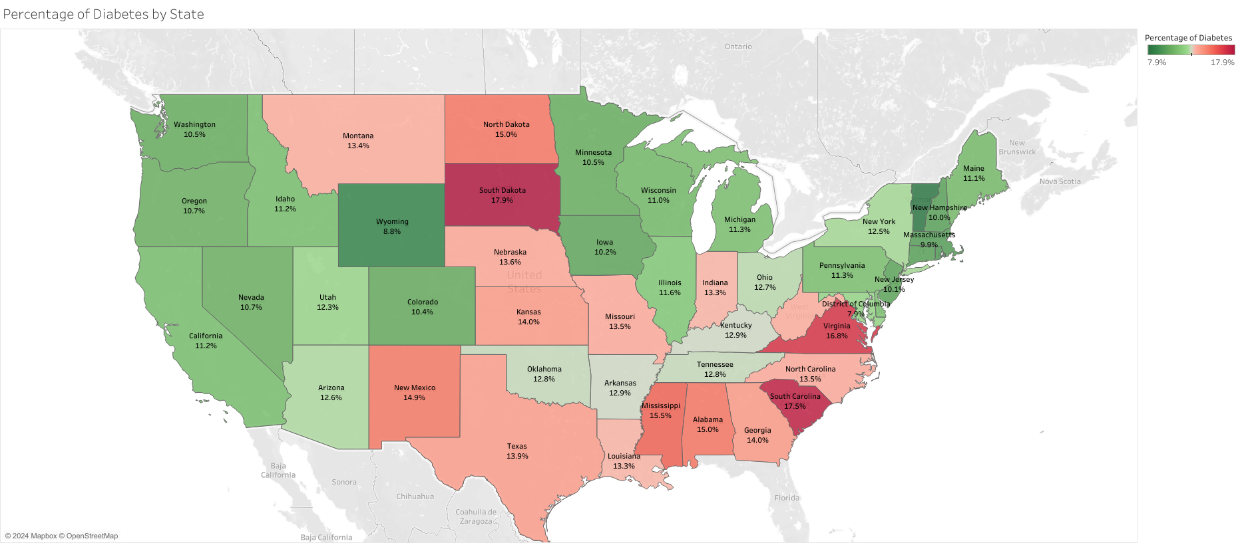
Percentage of diabetes by state
South Dakota
~17.9% have Diabetes
South Carolina
~17.5% have Diabetes
Virginia
~16.8% have Diabetes
Mississippi
~15.5% have Diabetes
T
1

Slide 8
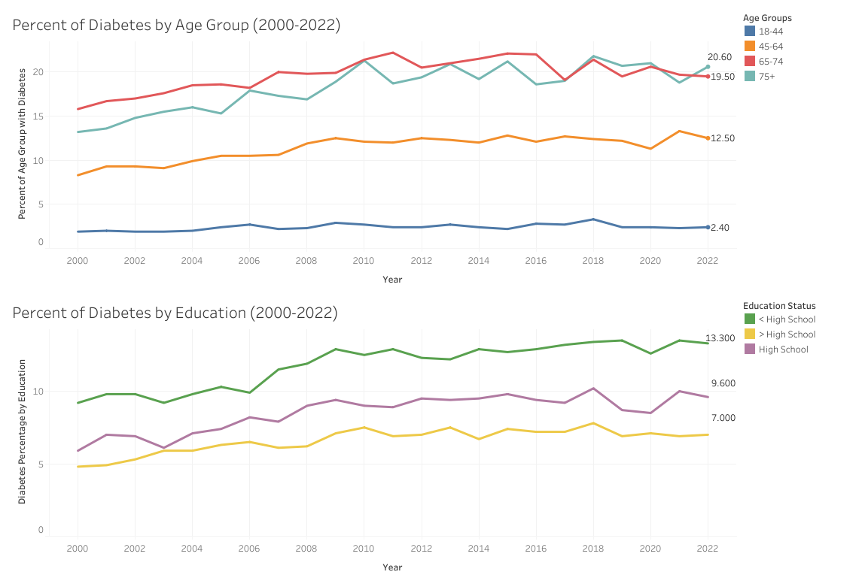
Demographics
Age Group
Trend in the older age groups has been increasing
Education
Lower educated population contain higher % of diabetes
T
1

Slide 9
Common Factors
02
T
2

Slide 10
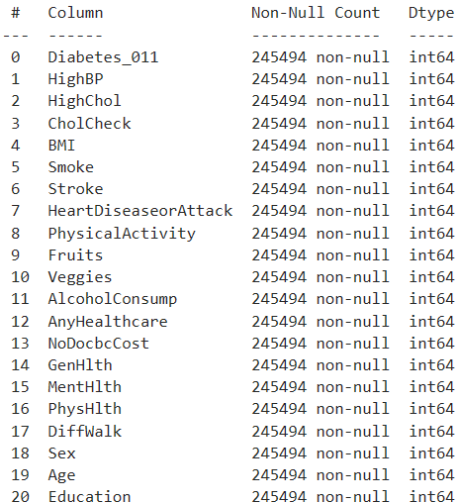
Data Exploration
The entire dataset was numerical, with no nulls, including the target column, Diabetes_012, which facilitates machine learning model building.
Most of the data, however, are discrete, categorical values, meaning that correlation may be more difficult to observe through pairplotting.

Slide 11
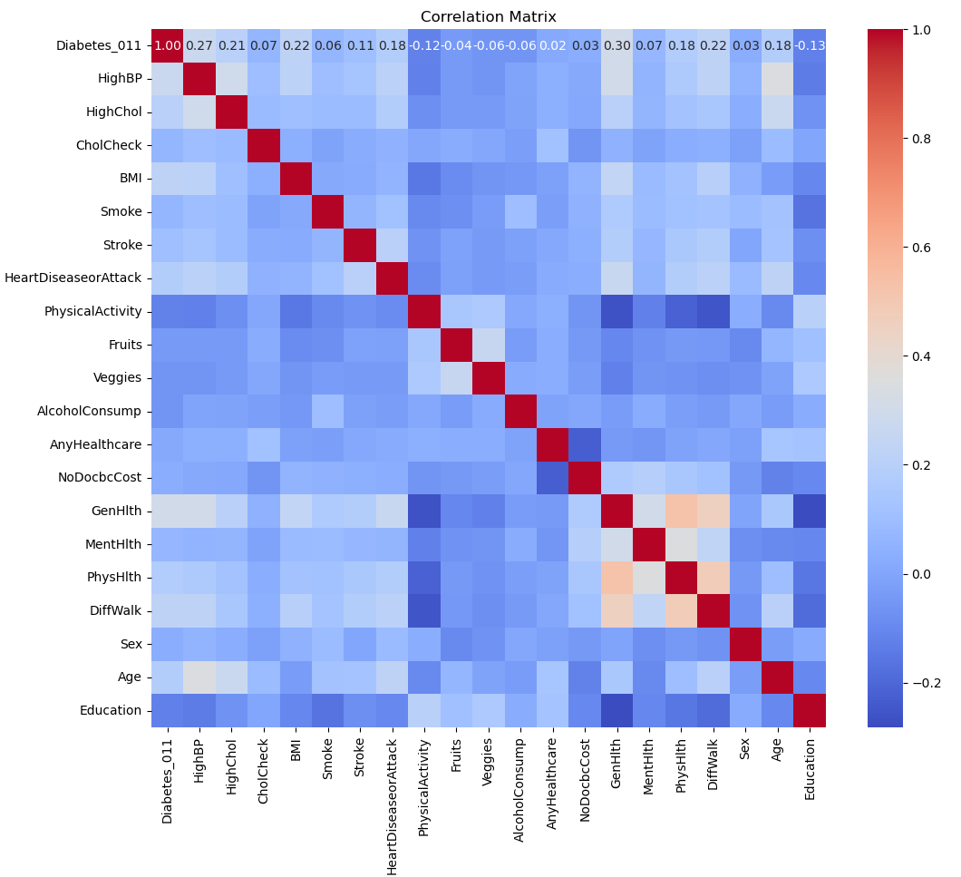
Data Exploration: Correlation
A few groups of attributes were more highly correlated to each other such as general health, walking amount, physical health, and mental health.
Another group included high blood pressure high cholesterol, age, and general health.
Features most correlated with diabetes included general health, BMI, high blood pressure, and heart disease or attack.
This suggests that if we were to perform dimension reduction, that these groups of variables may be grouped together after dimensionality reduction (through PCA).

Slide 12
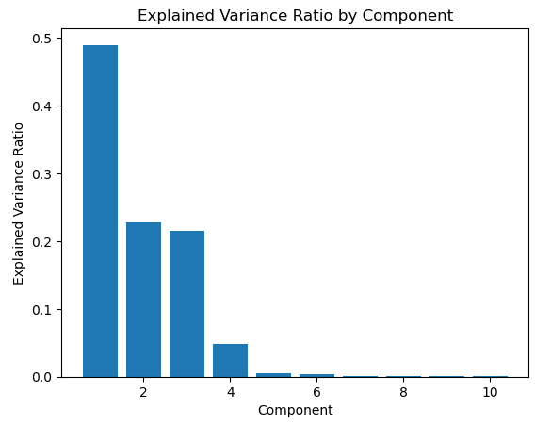
Data Exploration: PCA pt. 1
When performing PCA on the data before scaling the data, we see that the most of the variability in the data can be explained by the top 3 principal components.
However, the attributes that contribute most to the top 4 principal components are very similar:
Principal Component PC1:
1. Physical Health
2. Mental Health
3. BMI
Principal Component PC2:
1. BMI
2. Mental Health
3. Physical Health
Principal Component PC3:
1. Mental Health
2. Physical Health
3. Age
Principal Component PC4:
1. Age
2. Mental Health
3. Physical Health

Slide 13
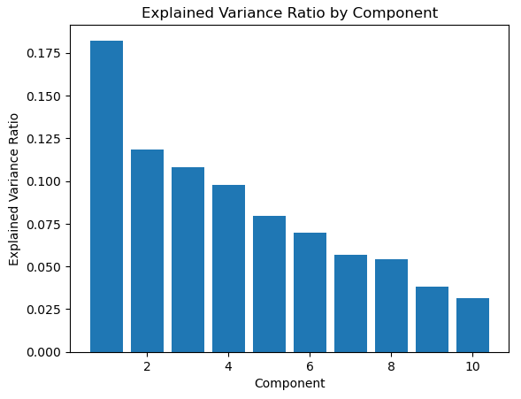
Data Exploration: PCA pt. 2
When performing PCA on the data after scaling the data, we see that the most of the variability in the data needs more principal components to explain more of the variability.
However, the attributes that contribute most to the top 4 principal components are less similar:
Principal Component PC1:
1. High Blood Pressure
2. High Cholesterol
3. Smoke
Principal Component PC2:
1. Sex
2. Fruits
3. Smoke
Principal Component PC3:
1. Sex
2. PhysicalActivity
3. Fruits
Principal Component PC4:
1. Smoke
2. Fruits
3. HighChol

Slide 14
Data Exploration: Takeaways
Prior to scaling: The top 3 principal components explain 93% of the variability
After scaling: Then, you need the top 10 components to explain at least 84% of the variability
Prior to scaling: The attributes that contribute to the top 3 principal components are very similar
After scaling: The attribute that contribute to each of the 10 principal components are more different
Tradeoff: No scaling means less principal components explain variability better, which would be better for model building. However, using scaling means you'll need more principal components, but each component is more unique, which would make a machine learning model more explainable.

Slide 15
03
Logistic
Regression
& Classification Method
T
3

Slide 16
Preprocessing data
Balancing
distributions
Reduced the number of people without diabetes so that it’s equal to those who have diabetes
01
03
Categorical encoding
02
Standard scaling
Removed type-1 and only used those with type-2 diabetes to compare against those w/o diabetes.
Ensured all features have the same scale.
Notes:
Balancing Class Distributions:
Reduced the number of people without diabetes.
Made equal amount of data between patients with diabetes and those without diabetes.
Standard Scaling (Normalization):
Ensured all features have the same scale.

Slide 17
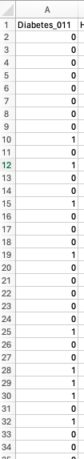
Supervised learning
Logistic Regression
Rationale: Target variable is binary (0 & 1)
0: no diabetes
1: type-2 diabetes
Steps
Created the model
Fit the model
Created prediction
Built a confusion matrix & classification report

Slide 18
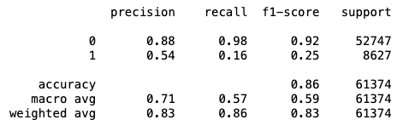
Logistic regression result
Before preprocessing

Slide 19
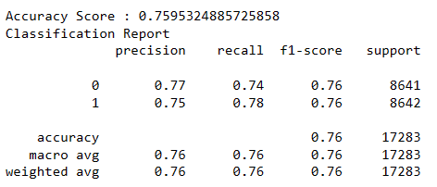
Logistic regression result
After preprocessing

Slide 20
04
Decision tree &
random forest
Supervised learning Models
T
4

Slide 21
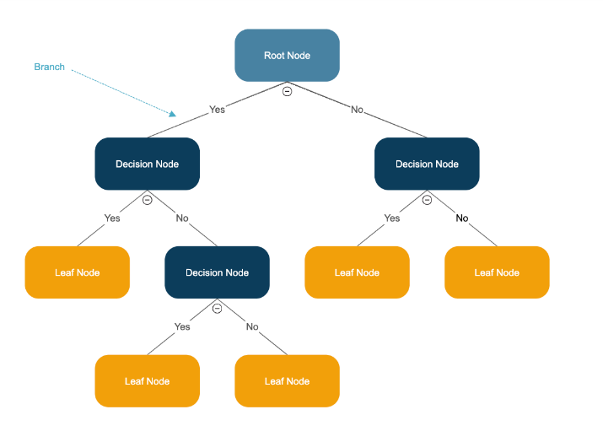
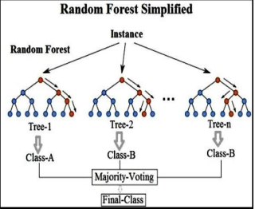
Decision tree &
random forest

Slide 22
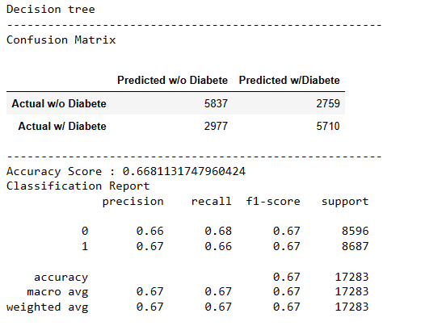
Decision tree result

Slide 23
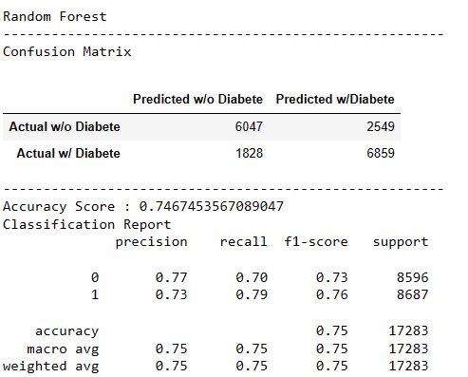
Random forest result

Slide 24
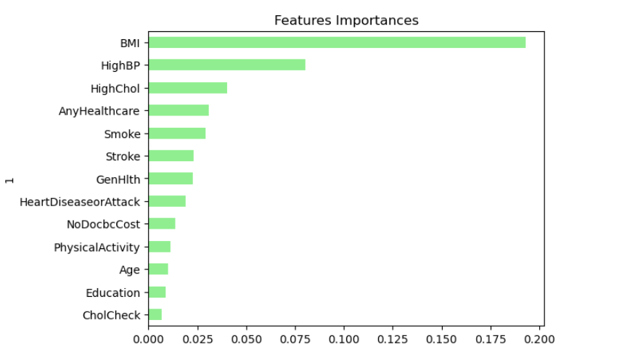
Random forest
Importance of feature

Slide 25
05
Neural network
T
5

Slide 26
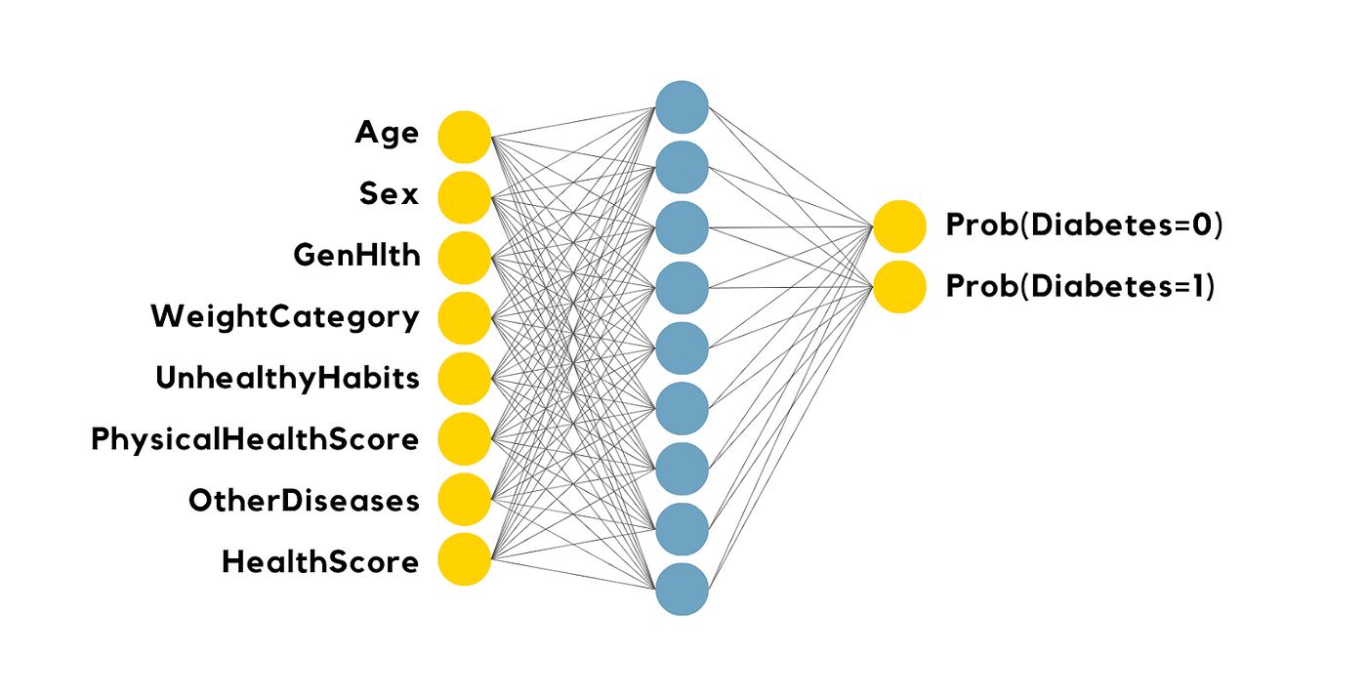

Neural network
Health wellness : (accuracy 86%)
High BP, High Cholesterol, CholCheck, BMI, DiffWalk
Behavioral: (accuracy 85%)
Smoke, Fruits, Veggies, Alcohol Consump, Physical Activity
Medical: (accuracy 86%)
Heart Disease or Attack, Stroke, Any Healthcare, GenHlth, Ment Hlth, Phys Hlth
Bio : (accuracy 84%)
Sex, Age, Education, NoDocbcCost
T
5
Notes:
We applied a neural network to check the accuracy, as we have three different types of diabetes. We utilized an encoder and categorical crossentropy. We achieved an 85% accuracy, which is excellent. Additionally, we experimented with different categories and parameters influencing our data, all resulting in the same overall accuracy.

Slide 27
06
CONCLUSIONS
T
6

Slide 28
CONCLUSIONS
History of Data
Geomap
Relationships between variables
Logistic Regression:
76% accuracy in predicting type-2 diabetes
Random Forest:
75% accuracy in predicting type-2 diabetes.
BMI, High blood pressure and High cholesterol have the most influences in random forest model
Neural network (Highest Accuracy):
86% accuracy in predicting type-2 diabetes.

